Slide 1
OBJECT DETECTION USING YOLO
su
Under the supervision of
Dr. P Praveen(Dr.Zameer Gulzar)
Associate Professor School of
Computer Science & Artificial Intelligence
Presented for
Milestone 3-Final Minor Project Review
Date:26-04-2024
Candidate No. & Name
HTNO. | Name
2103A52013 | Sanjay Swaran Kumar
2103A52032 | Rohith Parsi
2103A52061 | N.Ankitha
2103A52097 | M.Ranga Yochana

Slide 2
Outline of the Presentation
S. No | Topic | S. No | Topic
1 | Abstract | 9 | Gaps identified
2 | Motivation and background | 10 | Problem Identification
3 | Objectives | 11 | Proposed Methodology
4 | Introduction | 12 | Algorithm Explanation
5 | Literature survey | 13 | Implementation and Results
6 | Existing system | 14 | Comparative study
7 | Disadvantage | 15 | Conclusion and Future Scope
8 | Existing methodology

Slide 3
ABSTRACT:
The YOLO (You Only Look Once) object identification approach is gaining attention for automatic vehicle counting from video footage. However, the current study's adequacy in terms of accuracy and flexible interval counting remains unclear. This research aims to develop computer algorithms using the YOLO model for variable interval counting to automatically count traffic from pre-recorded films. The algorithms will recognize, track, and count automobiles using OpenCV and the TensorFlow API implementation of the YOLO model.

Slide 4
MOTIVATION AND BACKGROUND:
Implementing vehicle detection using YOLO on campus can enhance security, optimize traffic management, and improve parking efficiency.
This involves understanding computer vision and deep learning, collecting annotated datasets, training the model, considering hardware requirements, and integrating the system into existing infrastructure.

Slide 5
OBJECTIVES:
Real-Time Detection
High Accuracy
Robustness
Generalization
Scalability
Efficient Resource Usage
Adaptability

Slide 6
INTRODUCTION:
Object identification is a fundamental task in computer vision that involves detecting and classifying objects in images or videos.It is an essential component in various applications, such as autonomous driving, surveillance systems, and augmented reality.
It allows for real-time analysis of visual data, leading to improved efficiency, safety, and user experience.

Slide 7
LITERATURE SURVEY:
Title | Model | Merits | Demerits | Future Scope
VV-YOLO: A Vehicle View Object Detection Model Based on Improved YOLOv4 | Improved YOLOv4 (VV-YOLO) | High precision and mAP, handles challenging scenarios | Requires exploration for real-time deployment on constrained devices | Lightweight versions of VV-YOLO for broader use
YOLO-Based Object Detection and Tracking for Autonomous Vehicles Using Edge Devices | YOLO (optimized for edge devices) | Real-time object detection and tracking for autonomous vehicles on limited hardware | Lacks explicit accuracy/mAP data | Integration with other perception sensors for robust autonomous vehicle navigation
Real-Time Vehicle Detection Based on Improved YOLO v5 | Improved YOLOv5 with Flip-Mosaic data augmentation | Good accuracy for highway vehicle detection, effective for small objects | May not generalize well beyond highways | Evaluation on broader datasets with diverse traffic conditions
Research on vehicle detection based on improved YOLOX_S | Improved YOLOX_S with focus on anchor box optimization | Competitive mAP with lightweight architecture | Lacks details on specific accuracy improvements | Performance evaluation in real-world traffic scenarios with varying weather/lighting
A Lightweight YOLOv3-tiny Network for Real-Time Traffic Sign Detection | Lightweight YOLOv3-tiny (adaptable for vehicle detection) | Good balance between accuracy and efficiency | Primarily focused on traffic signs, adaptation for vehicles might require modifications | Transfer learning for vehicle detection tasks

Slide 8
D²-YOLO: A Dilated Residual YOLO Network for Real-Time Traffic Light Detection | D²-YOLO (adaptable for vehicle detection) | High accuracy and fast inference speed for traffic light detection | Requires adaptation and evaluation on vehicle detection benchmarks | Transfer learning to leverage the model's strengths for vehicle detection
Object detection using YOLO: challenges, architectural successors, datasets and applications | Review paper on YOLO variants for object detection | Comprehensive overview of YOLO's evolution and applications | Doesn't focus specifically on vehicle detection | Analyzing YOLO successors (e.g., YOLOv7) for vehicle detection tasks
Attentional YOLOv5 for Real-Time Multi-Vehicle Detection on Low-Resolution Videos | Attentional YOLOv5 for low-resolution videos | Good accuracy for vehicle detection in low-resolution videos, suitable for resource-constrained devices | May not perform as well on high-resolution videos | Incorporation of super-resolution techniques for low-resolution video performance
You Only Look Once: Unified Real-Time Object Detection (Redmon and Farhadi, 2016) | YOLOv1 | Pioneering work in real-time object detection | Lower accuracy compared to newer YOLO models | Reference for understanding YOLO's foundation and later advancements
Focal Loss for Dense Object Detection (Lin et al., 2017) | Introduces Focal Loss function for YOLO | Improves accuracy for object detection tasks, especially for imbalanced datasets | May require adjustments for specific vehicle detection applications | Explore integration of Focal Loss with various YOLO models for vehicle detection tasks

Slide 9
EXISTING SYSTEM:
Faster R-CNN (Region-based Convolutional Neural Network):
It first suggests areas where vehicles might be hiding, then carefully checks each one to confirm if there's a vehicle there. While it's not as fast as YOLO, it's quite accurate in identifying vehicles.
SSD (Single Shot MultiBox Detector):
SSD is like a speedier version of Faster R-CNN. It doesn't waste time with two stages; instead, it swiftly checks the entire video at once and marks where vehicles are likely to be. While not as fast as YOLO, it's quicker than Faster R-CNN and still does a good job of spotting vehicles.

Slide 10
DISADVANTAGE:
High computational requirements.
Dependence on large, labeled datasets.
Tendency to overfit.
Lack of interpretability.
Limited generalization to different environments.
Sensitivity to variations like lighting and weather.
.

Slide 11
EXISTING METHODOLOGY:
Data Collection & Annotation: Gather videos with vehicles, label each frame with bounding boxes.
Data Preprocessing: Resize, normalize, augment, and balance the dataset.
Model Selection: Choose YOLO, Faster R-CNN, or SSD based on speed and accuracy.
Model Training: Train the chosen model to minimize prediction errors.
Model Evaluation: Assess accuracy, precision, and recall on a separate dataset.
Deployment & Iteration: Deploy the model for vehicle detection, refining it based on feedback.

Slide 12
GAPS IDENTIFIED:
In existing campus vehicle detection methods include limited accuracy, scalability issues, lack of real-time monitoring, resource-intensive processes, and potential high costs.
These gaps highlight the need for more efficient, automated solutions like YOLO to enhance security and traffic management on campus.

Slide 13
PROBLEM IDENTIFICATION:
Limited accuracy, scalability issues, lack of real-time monitoring, resource-intensive processes, and potential high costs in existing campus vehicle detection methods.
These issues underscore the necessity for more efficient, automated solutions like YOLO to enhance campus security and traffic management.

Slide 14
PROBLEM STATEMENT:
The demand for object detection algorithms that can accurately identify and locate objects in real-time has been increasing rapidly.
Traditional object detection methods and deep learning approaches often suffer from limitations in accuracy and speed, making them less suitable for real-world applications.
There is a need for advanced algorithms that can overcome these challenges and provide accurate and efficient object detection solutions.

Slide 15
PROPOSED METHOD:
The proposed approach involves implementing a real-time vehicle identification and tracking system on college campus using YOLO technology.
The system includes vehicle counting functionality and a user-friendly interface. YOLO is chosen for its suitability in real-time vehicle detection, and subsequent model training to refine its accuracy in diverse environmental conditions.
The ultimate goal is to improve the efficiency, safety, and traffic management on college campus by continuous improvement and technological advancements.

Slide 16
YOLO ALGORITHM:
The YOLO (You Only Look Once) algorithm is a popular object detection algorithm in computer vision. Unlike traditional methods that require multiple passes over an image, YOLO performs object detection in a single pass.
The key idea behind YOLO is to divide the input image into a grid and predict bounding boxes and class probabilities for each grid cell. This allows YOLO to detect multiple objects in an image efficiently.
YOLO uses a convolutional neural network (CNN) architecture to extract features from the input image.
YOLO is known for its real-time object detection capabilities and is widely used in applications such as autonomous driving, surveillance systems, and robotics.

Slide 17
WORKING OF YOLO:
Input Image: The input image is divided into a grid of cells.
Grid Cells: Each grid cell predicts bounding boxes and class probabilities.
Bounding Box Prediction: Each grid cell predicts multiple bounding boxes, each represented by a set of coordinates (x, y, width, height).
Class Prediction: Each grid cell also predicts class probabilities for the objects present in the bounding boxes.
Non-Maximum Suppression: The predicted bounding boxes are filtered using non-maximum suppression to remove redundant detections.
Output: The final output is a set of bounding boxes and their corresponding class labels.

Slide 18
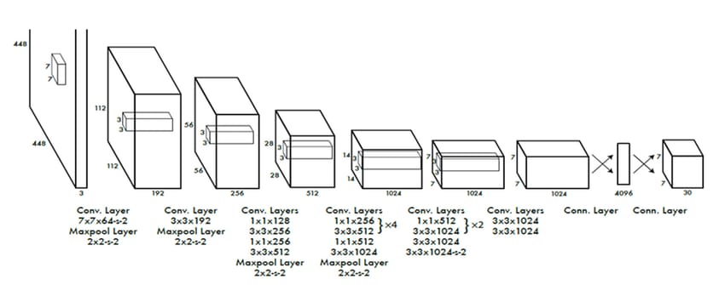
ARCHITECTURE:

Slide 19
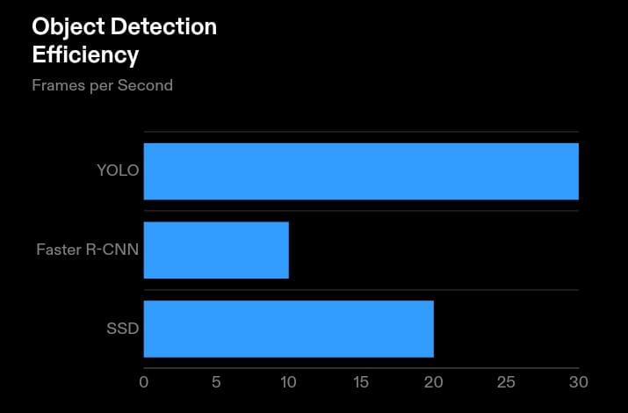
REAL-WORLD EFFICIENCY:
YOLO : YOLO demonstrates the highest efficiency with a frame rate of 30 frames per second.
Faster R-CNN : Faster R-CNN achieves a frame rate of 10 frames per second, which is slower compared to YOLO.
SSD : SSD performs better than Faster R-CNN but is still slower than YOLO with a frame rate of 20 frames per second

Slide 20
CONCLUSION AND FUTURE SCOPE
In short, object detection using YOLO offers real-time processing and high accuracy, but faces challenges with precise localization, small objects, and resource-intensive training.
Despite limitations, YOLO is widely used in applications like surveillance and autonomous driving, with ongoing efforts to improve its performance and versatility.
The future scope for the project involves continuous innovation and expansion to address evolving challenges and opportunities in campus transportation management and smart city development.

